Slide 1
Magento Introduction & Installation
By Shatir Jhetam

Slide 2
Magento
Introduction (What is Magento?)
Features of Magento.
Installation of Magento.

Slide 3
Introduction
Magento
Free Version
Licensed Versions
Community Edition
1.7.0.2
Professional Edition
1.12.0.2
Enterprise Edition
1.13
Magento is an open source e-commerce web application that was launched on March 31, 2008.
It was developed by Varien (now Magento Inc) with help from the programmers within the open source community but is owned solely by Magento Inc.
Magento was built using the Zend Framework.
It uses the entity-attribute-value (EAV) database model to store data.

Slide 4
Introduction…
In February 2011, eBay announced it had made an investment in Magento in 2010, worth a 49% ownership share of the company.
As of June 6, 2011 eBay owns 100% of Magento. eBay announced that Magento would join eBay's new X.Commerce initiative.

Slide 5
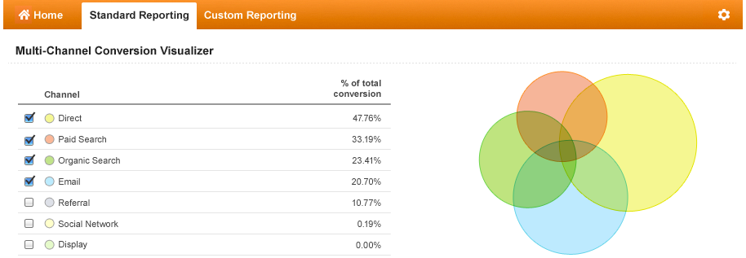
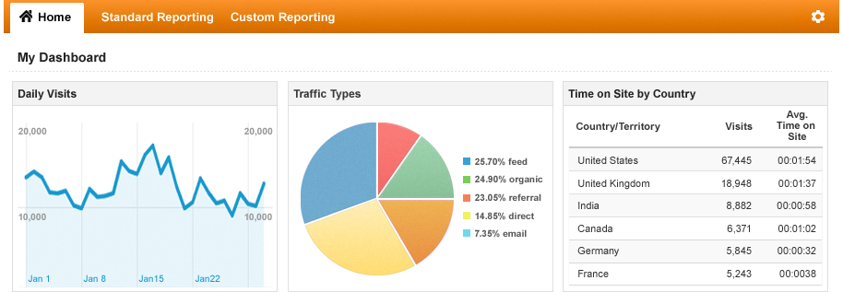
Features of Magento
Analytics and Reporting - the script is integrated with Google Analytics and offers many different reports.
Product Browsing - multiple images for products, options for extensive reviews, wishlists and much more.
Catalog Browsing - easy navigation, advanced product filtering system, product comparison.
Catalog Management - inventory management, batch import and export of products, different tax rates per location, additional product attributes.
Customer Accounts - order status and history, e-mail and RSS feeds for products in the wishlist, newsletter subscription, default billing and shipping address.
Customer Service - enhanced features for customers' accounts, Contact Us form, comprehensive order tracking and history, customizable order e-mails.
Order Management - create orders through admin area, create multiple invoices shipments and credit memos, call center order creation option.

Slide 6
Features of Magento…
Payment - different payment methods: credit cards, PayPal, Authorize.net, Google Checkout, checks, money orders, support of external payment modules like Cybersource, ePay, eWAY and many more.
Shipping - shipping to multiple addresses, flat rating shipping, supports UPS, UPS XML (account rates), FedEx (account rates), USPS and DHL.
Checkout - one page checkout, SSL support, checkout without having an account.
Search Engine Optimization - 100% Search Engine Friendly, Google SiteMap support.
International Support - multiple languages and currencies, list of allowed countries for registration, purchasing and shipping, localization.
Marketing Promotions and Tools - coupons, discounts and different promotion options.
Site Management - control of multiple web sites, multiple languages, tax rate with support for US and International markets, customizable outlook through

Slide 7
Magento Installation
Step 1:
Make sure you have the latest version of XAMPP installed.
Step 2:
Download the latest & stable Community Edition package(1.7.0.2).

Slide 8
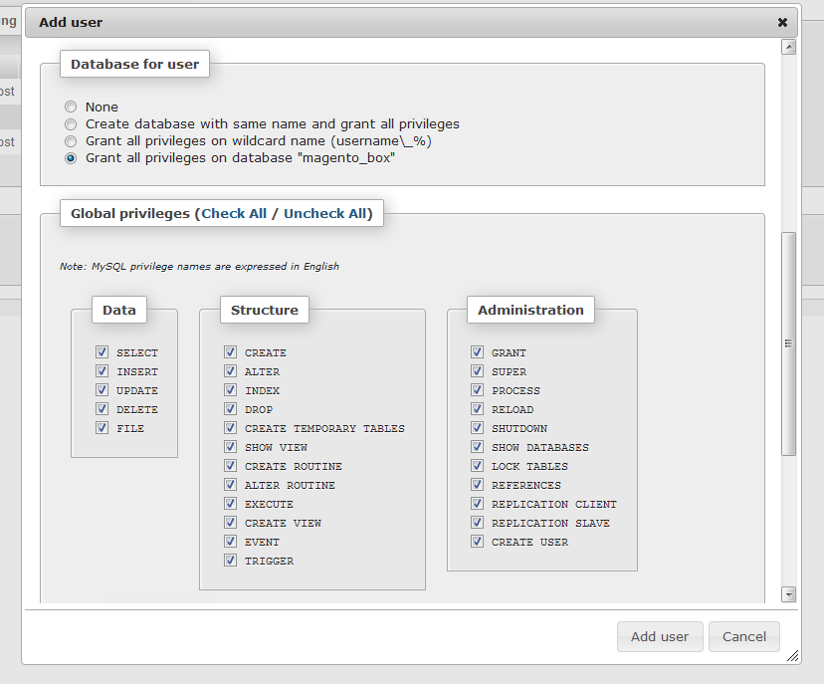
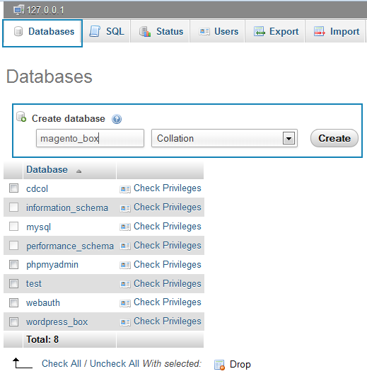
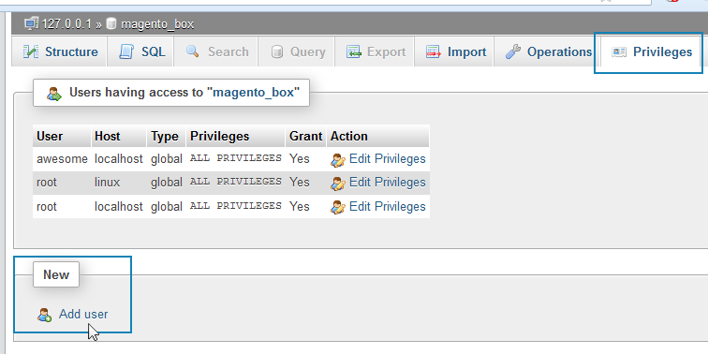
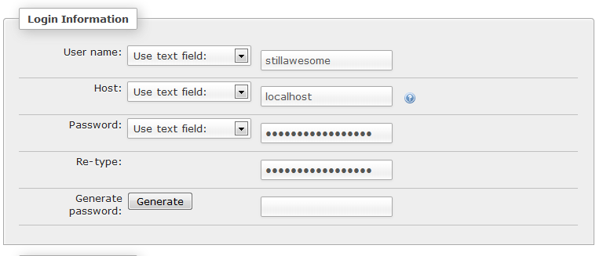
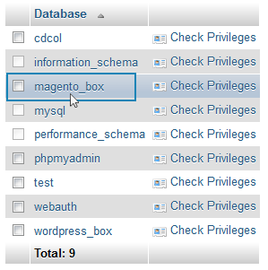
Magento Installation
Step 3:
Go to your localhost phpMyAdmin: http://localhost/phpmyadmin/
Click on Databases and create a magento database.

Slide 9
Magento Installation
Step 4:
Extract the downloaded package & rename the folder to your <project-name>. Eg : magento_box
Step 5:
Paste the folder in your htdocs folder (for local)
Note : If you’re working on a server, upload the package to your root directory and rename it.

Slide 10
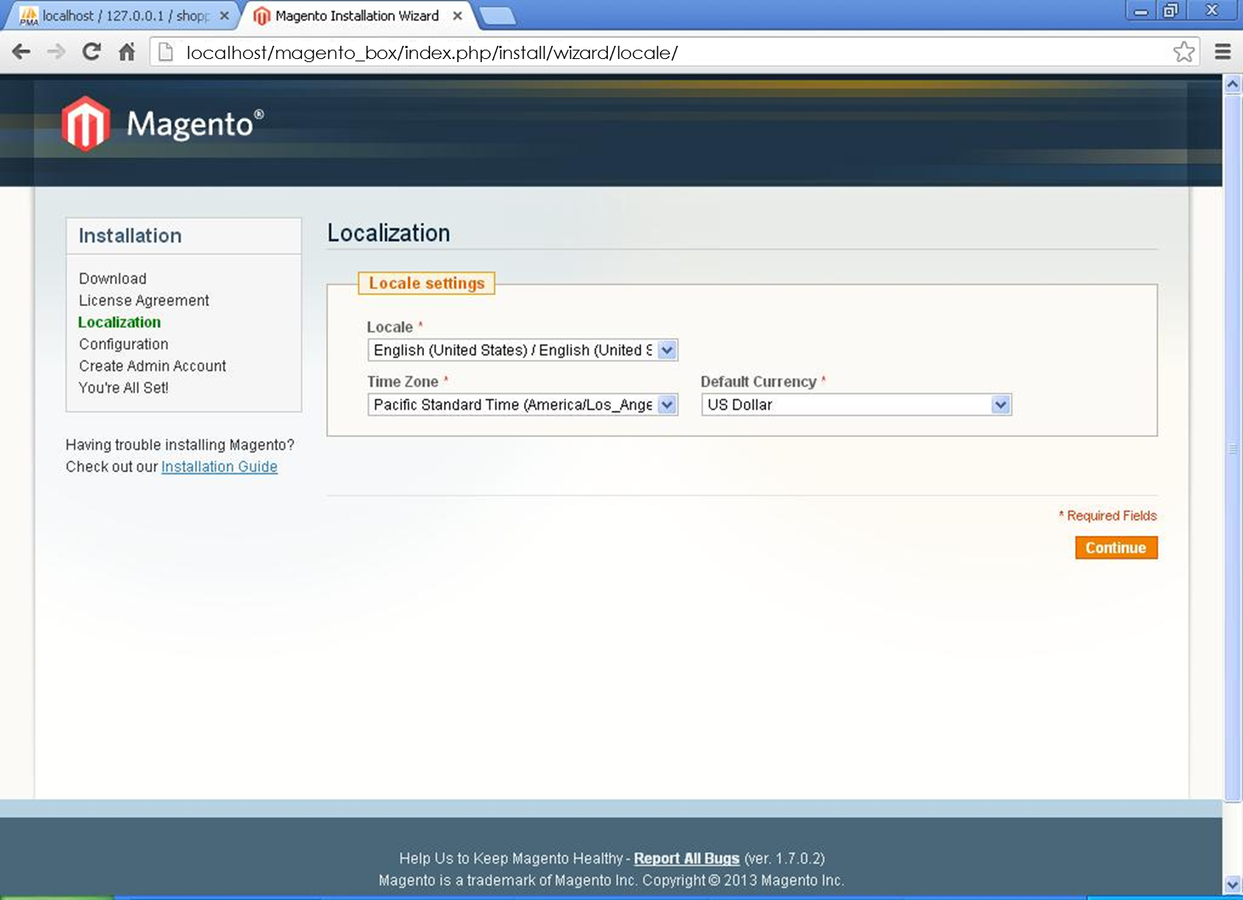
Magento Installation
Step 6:
Open up your browser and type in http://localhost/<project-name>
In this case : http://localhost/magento_box
This will begin the installation
Check the
“I agree to the above terms & conditions” and click on Continue.

Slide 11
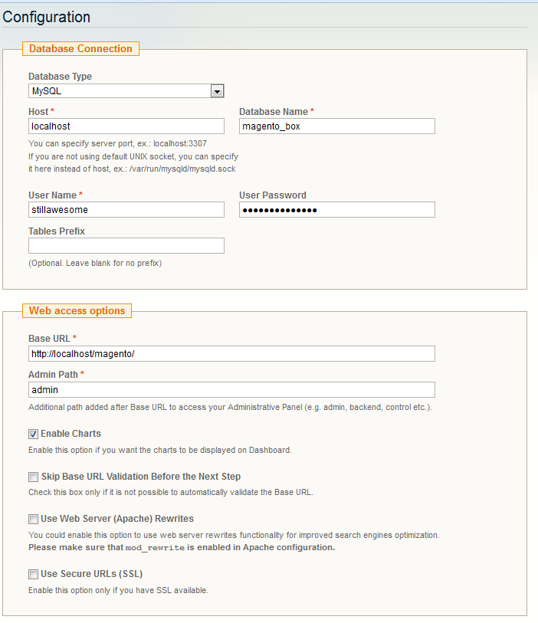
Magento Installation
Step 8:
Now enter Configuration Details

Slide 12
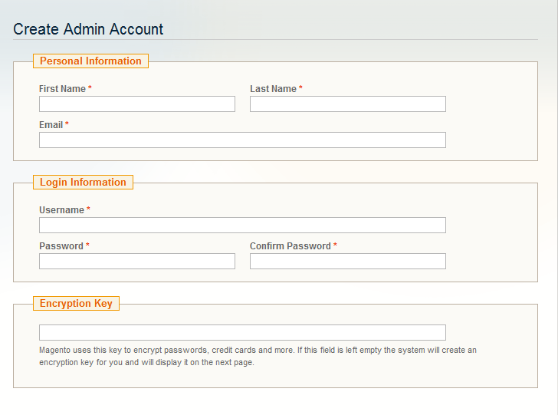
Magento Installation
Step 9:
Enter your personal information & login details for creating the admin account.

Slide 13
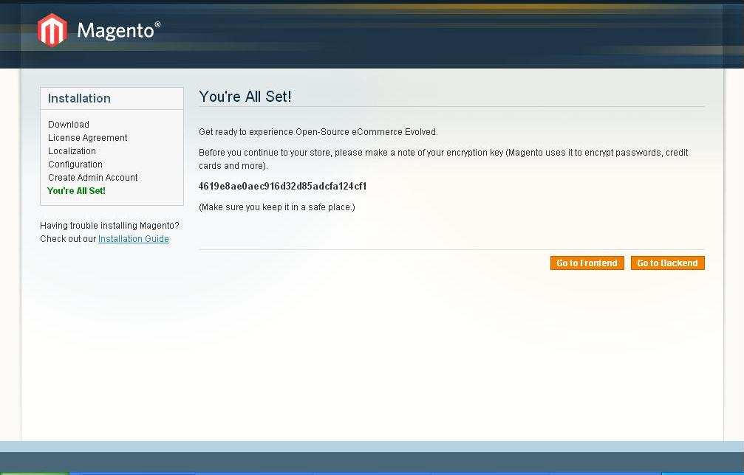
localhost/magento_box/index.php/install/wizard/locale/

Slide 14
References
http://www.ironion.com/installing-magento-on-xampp/
http://en.wikipedia.org/wiki/Magento

Slide 15
Thank You

